Slide 1

Writing PowerShell with VS Code
Rob Sewell, Sewells Consulting Moderated By: Elizabeth Noble
Presenting Sponsor
Notes:
Welcome to 24 Hours of PASS: Summit Preview 2018!
We’re excited you could join us today for Rob Sewell’s session, Writing PowerShell with VS Code.
This 24 Hours of PASS consists of 24 consecutive live webinars, delivered by expert speakers from the PASS community.
The sessions will be recorded and posted online after the event. You will receive an email letting you know when the recordings are available.
My name is Elizabeth Noble [you can say a bit about yourself here if you’d like]
I have a few introductory slides before I hand over the reins to Rob.
[move to next slide]

Slide 2
Notes:
If you require technical assistance please type your question into the question pane located on the right side of your screen and someone will assist you. This question pane is also where you may ask any questions throughout the presentation. Feel free to enter your questions at any time and once we get to the Q&A portion of the session, I’ll read your questions aloud to the speaker.
You are able to zoom in on the presentation content by using the zoom button located on the top of the presentation window.
Please note that there will be a short evaluation at the end of the session. Your feedback is important to us so please take a moment to complete it. This will pop-up after the webinar ends in your web browser.
[Note to moderators: You need to determine which questions are the most relevant and ask them out loud to the presenter].
[move to next slide]

Slide 3


Thank you to our Presenting Sponsor
Quest helps IT Professionals simplify administration tasks so they can focus on the evolving needs of their businesses. Combined with its commitment to help companies protect today’s investment while planning for the future, Quest continues to deliver the most comprehensive solutions to monitor, manage, protect and replicate database environments.
Notes:
I’d like to take a moment to thank our Presenting Sponsor, Quest.
The staging of 24 Hours of PASS would not be possible without their generous support, and they are the reason this event is available free of charge. If you would like to learn more about Quest and sign up for information on how they can help you, please visit the sponsors page of the 24 hours of PASS website.
[move to next slide]

Slide 4
Notes:
PASS is a global, not-for-profit association where data professionals Connect, Share and Learn. Joining PASS is free, and gives you access to hundreds of hours of free online content, live virtual and in-person events, the ability to join Local Groups in your area, and the opportunity to attend the annual conference, PASS Summit. PASS is a great way to connect with like-minded professionals, increase your technical expertise, and grow your career.
[move to next slide]

Slide 5
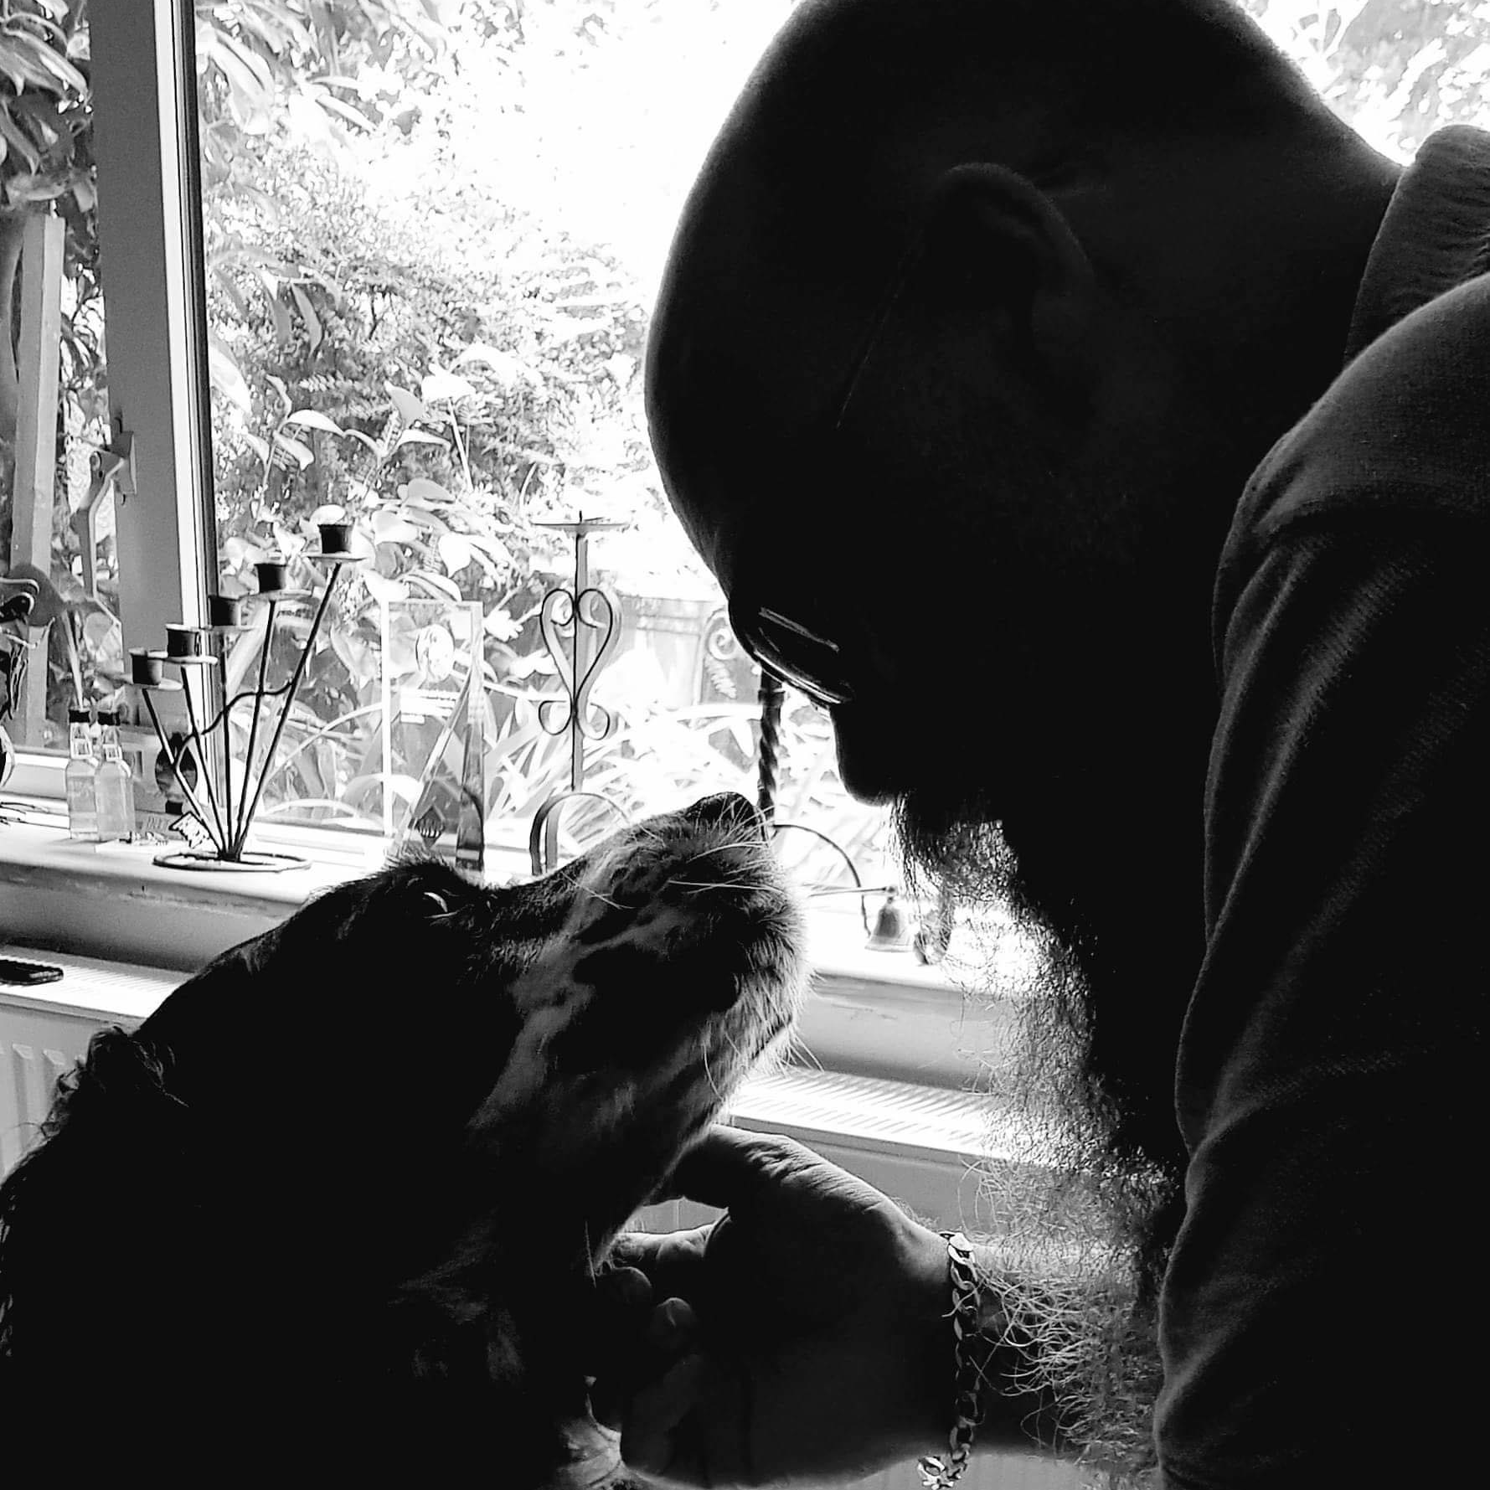
Rob Sewell
Sewells Consulting Limited
PowerShell Automator, PowerShell Trainer, Database DevOps
Volunteer, Speaker and Organizer
PowerShell and SQL user groups, national and international events
Sewells Consulting
Open Source
robsewellsqldba
Contributor and evangelist for dbatools, dbachecks, dbareports, OpenQueryStore
@sqldbawithbeard
W
sqldbawithAbeard.com
G
sqldbawithabeard
Notes:
[Moderator Part]
This 24 Hours of PASS session is presented by Rob Sewell. Rob is a SQL Server DBA with a passion for Powershell, Azure, Automation, & SQL. He is an MVP & has organized, spoken at & volunteered at many events. He is a proud supporter of the SQL & PowerShell communities.
He relishes sharing & learning & can be found doing both via Twitter & his blog. He spends most of his time looking at a screen & loves to solve problems. He knows that looking at a screen so much is bad for him because his wife tells him so. Thus, you can find him on the cricket field in the summer or flying a drone in the winter.
The important thing to note is that his twitter handle does not have an A in it. He tried to change it once and became SQL DBA With a Bear !!!!!
[move to next slide]

Slide 6
Writing PowerShell with VS Code
Rob Sewell, Sewells Consulting Moderated By: Elizabeth Noble
Presenting Sponsor
Notes:
And without further ado, here is Rob with Writing PowerShell with VS Code
{speaker begins}
**[Speaker takes over]**

Slide 7






Writing PowerShell Code
Notepad
Notepad ++
PowerShell ISE
Sapien PowerShell Studio
Visual Studio
Visual Studio Code

Slide 8
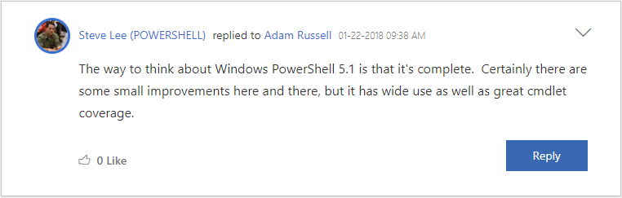
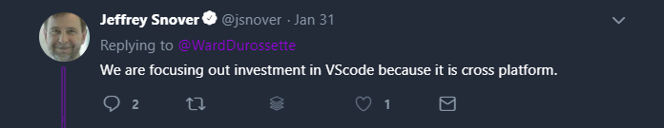
Why Not ISE?

Slide 9
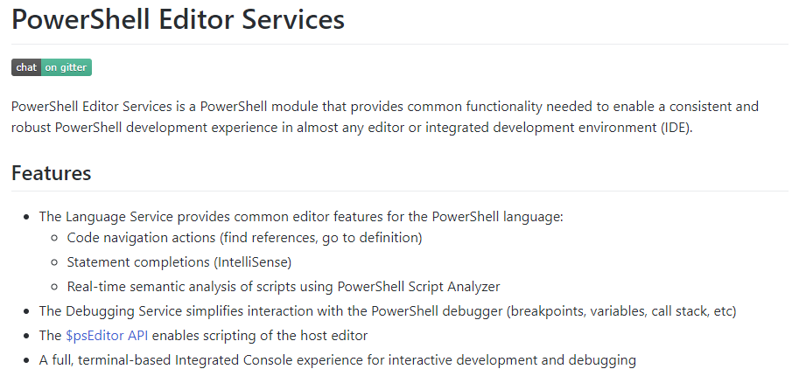
PowerShell Editor Services
powershell.github.io/PowerShellEditorServices/

Slide 10
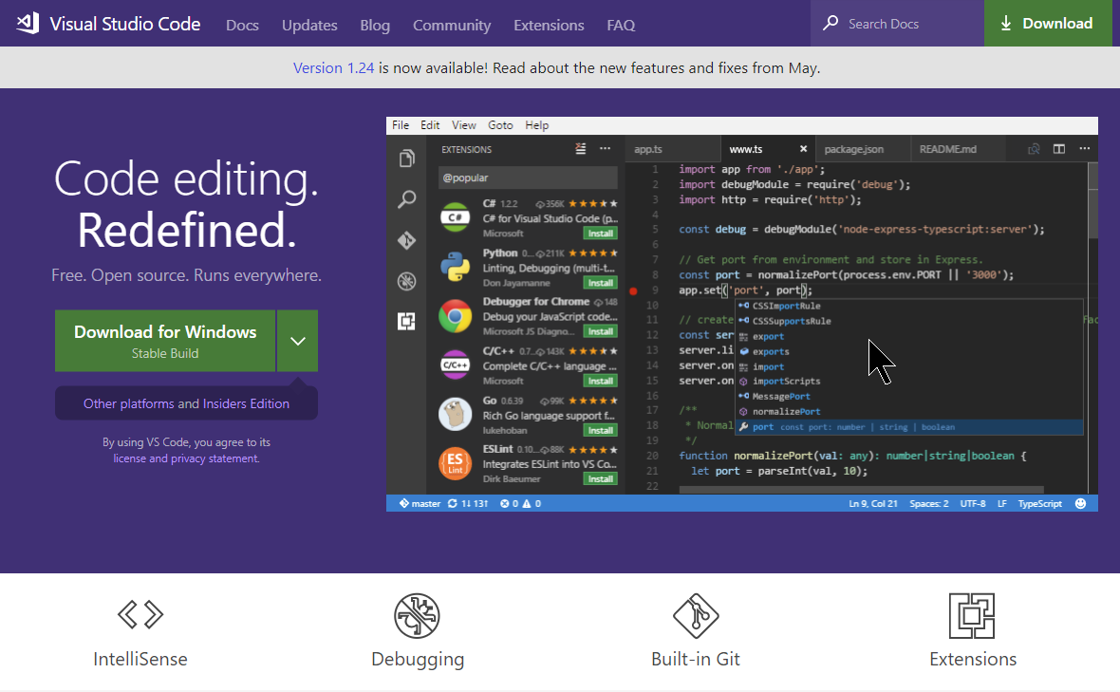
code.visualstudio.com

Slide 11
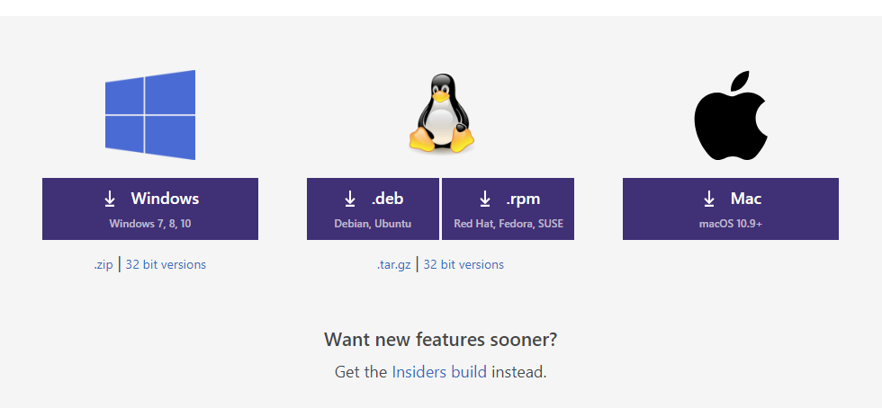
Multi-Platform

Slide 12
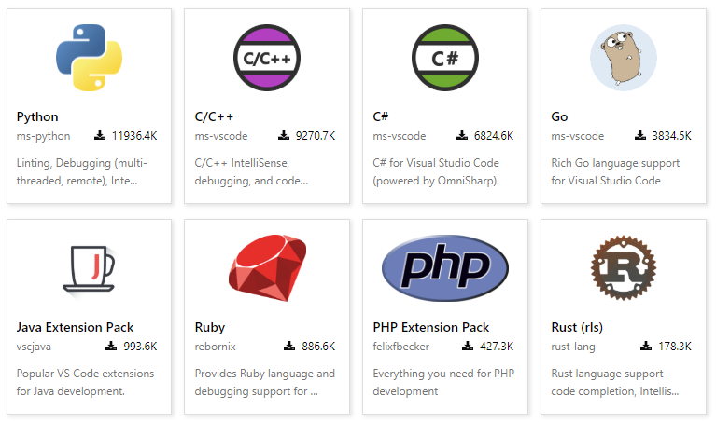
Multi-Language

Slide 13
Multi-Language
Batch
C#
C++
Clojure
Coffee Script
CSS
Dockerfile
F#
Go
Groovy
Jade
Java
JavaScript
JSON
HandleBars
HTML
Ini
Less
Lua
Makefile
Markdown
Objective-C
Perl
PHP
PowerShell
Python
R
Razor
Ruby
Rust
Sass
SQL
Swift
TypeScript
Visual Basic
XML

Slide 14
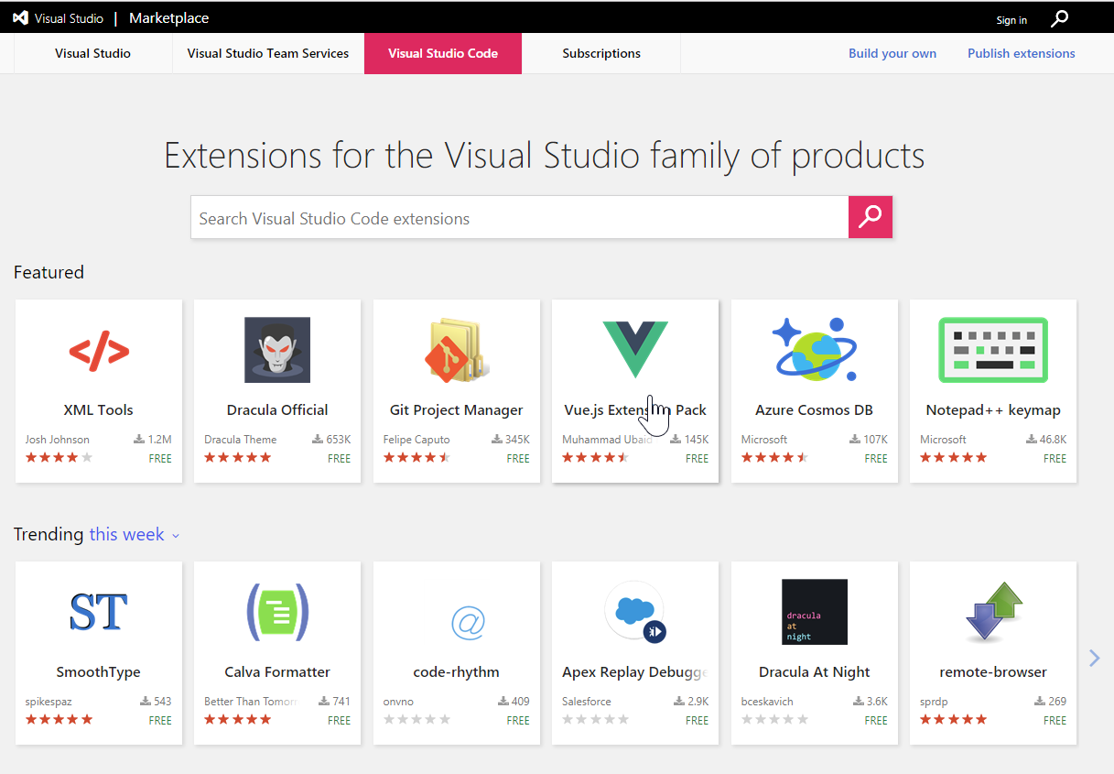
marketplace.visualstudio.com/vscode

Slide 15
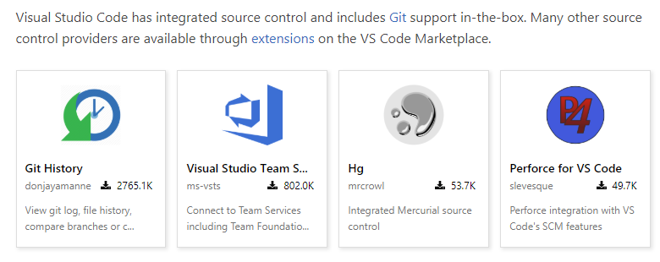
Multiple Source Control

Slide 16
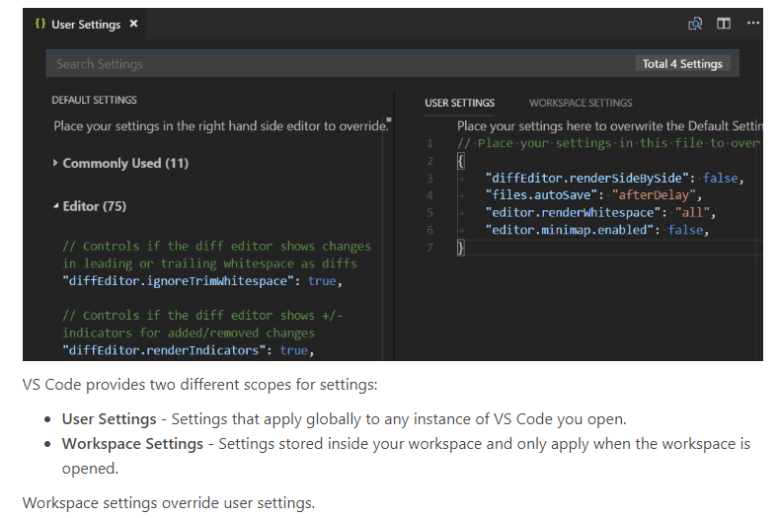
Configurable

Slide 17
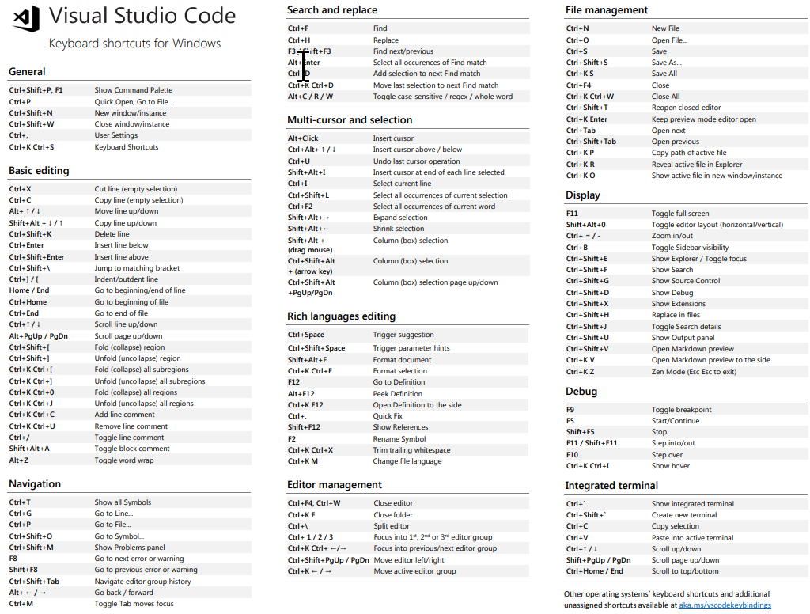
Keyboard Shortcuts
code.visualstudio.com/docs/getstarted/keybindings

Slide 18
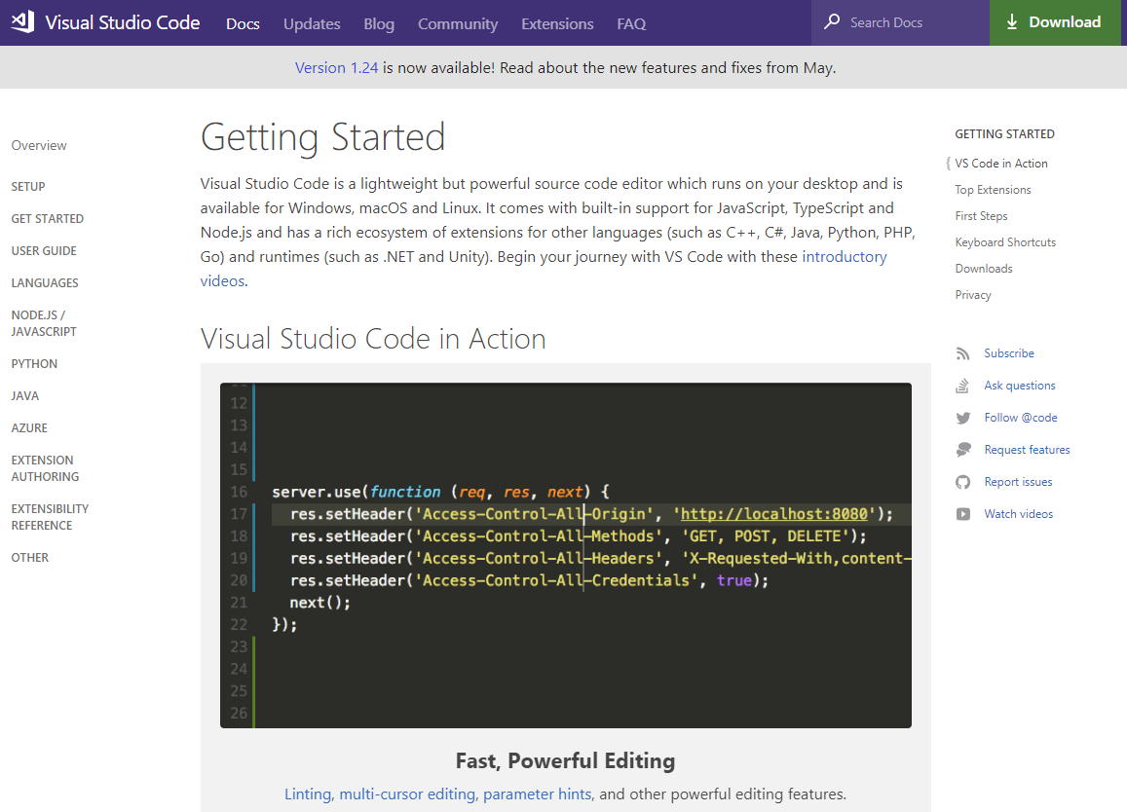
Get-Help
code.visualstudio.com/docs/

Slide 19
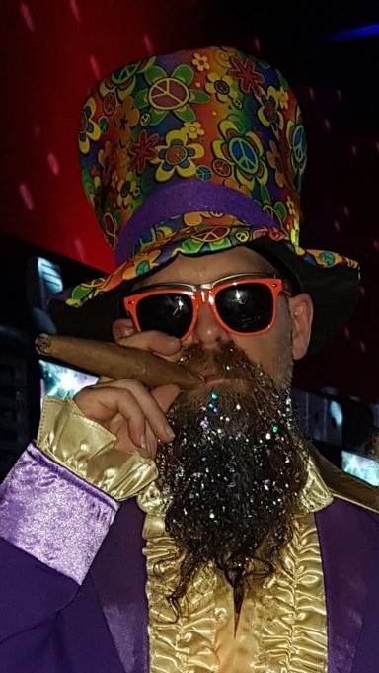
Hey Beardy – Enough Talk!
Time For A DEMO

Slide 20
Questions?
?
?
?
?
?
?
?
?
Notes:
[Moderator to Address questions in order of relevance]
[move to next slide]
Coming up next…

Slide 21
Database DevOps to Ensure Compliance
Steve Jones
Notes:
Stay tuned for our next session, Database DevOps to Ensure Compliance
With Steve Jones
[move to next slide]

Slide 22


@sqlpass #sqlpass @PASScommunity
Notes:
Thank you all for attending!
[move to next slide]

Slide 23
Presenting Sponsor

